Slide 1
Hand Detection using Multiple Proposals Arpit Mittal, Andrew Zisserman and Philip H. S. Torr
Speaker: Zhong Zhang

Slide 2
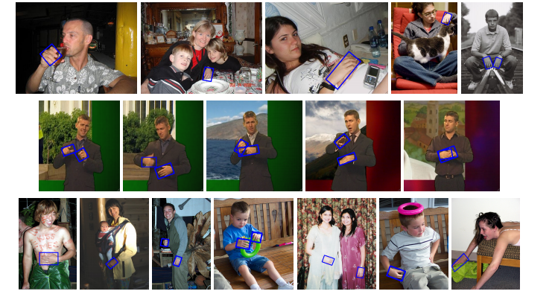
Objective
Detect and localize human hands in real-world still images.

Slide 3
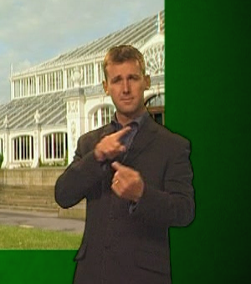
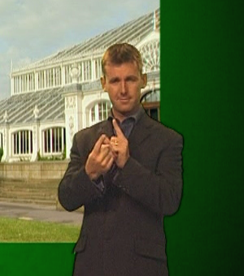
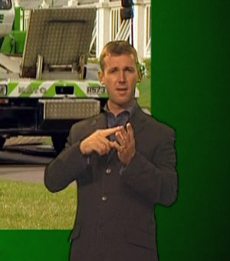
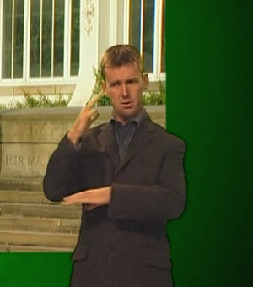
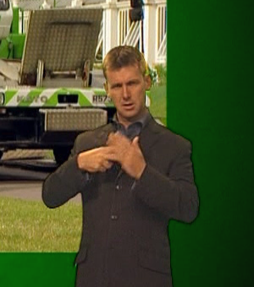
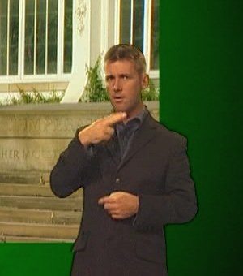
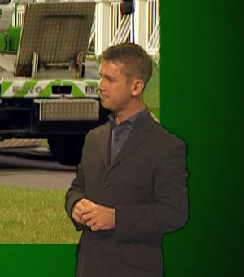
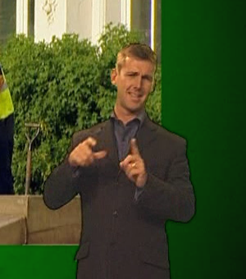
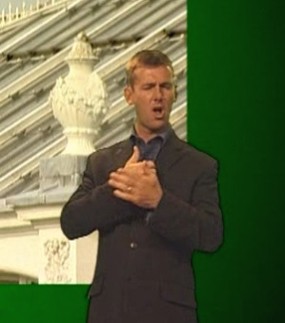
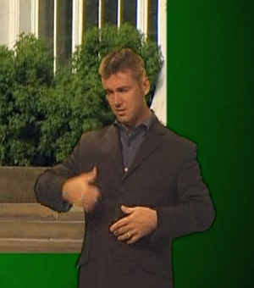
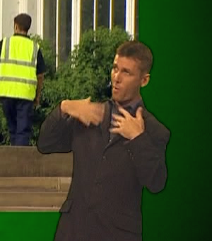
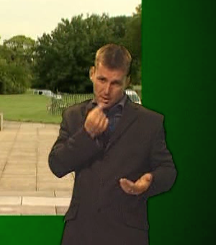
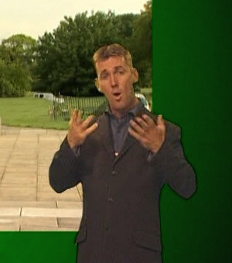
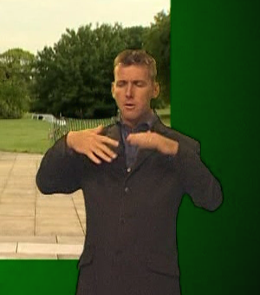
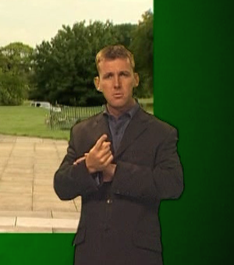
Signer Dataset

Slide 4
Approach
The paper describes a two-stage method for detecting hands and their orientation in still images.
The first stage uses three complementary detectors to propose hand bounding boxes. And each bounding box is then scored by the three detectors independently.
A second stage classifier learnt to compute a final confidence score for every bounding box using its associated features.

Slide 5
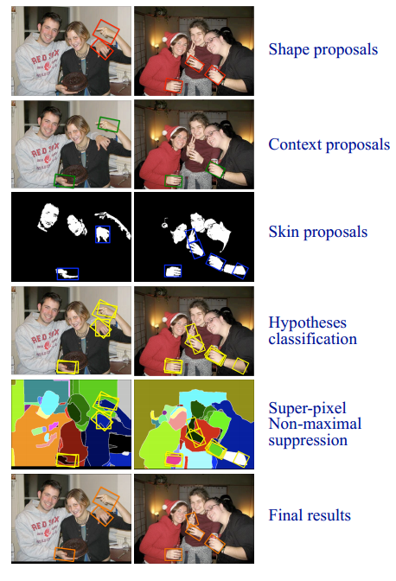
Approach

Slide 6
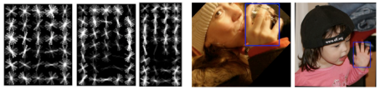
Hand shape detector
Sliding window hand shape detector is learned using Felzenszwalb et al.’s parts based model over aligned hand instances.
The detector is trained as a mixture model with three components.
Testing is performed at 10 intervals of rotation of the image.
(a)
(b)
(a) Root filters for the three components of the hand-shape detector. The first two filters cover frontal pose and the third filter profile. (b) Rotated training images so that bounding boxes are aligned.

Slide 7
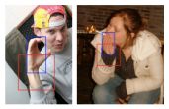
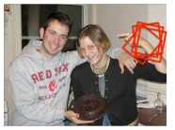
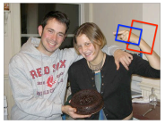
Context detector
Context detector is learned just like the
hand detector over the region around the
hand bounding box.
Testing is performed at 10 intervals of rotation.
Max-pooling of scores is done over all boxes having overlap score above 0.5.
Hand bounding boxes are obtained by shrinking the context boxes.
Detected context boxes
Context box with max score

Slide 8
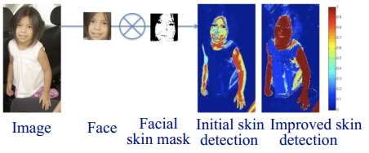
Skin detection and hypotheses generation
Detect faces in the image using openCV face detector.
Skin color model is learned locally from the face pixels.
A simple classifier of color likelihood is used based on a histogram of the face pixels to detect skin regions.
The color of the neighboring pixels is used to update the color likelihood classifier and the process is repeated.

Slide 9
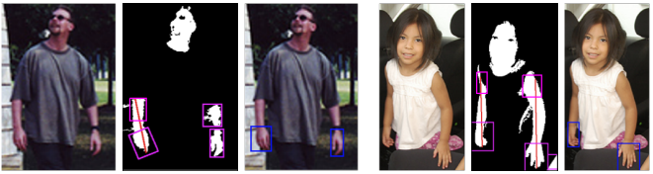
Skin detection and hypotheses generation
Lines are fitted to skin regions and hands are hypothesised at both ends of the lines.
If the skin region resembles a blob then the whole skin region is hypothesised as a hand.
Detection score is given by the proportion of skin pixels to other pixels in the largest super-pixel within the hypothesised box.

Slide 10
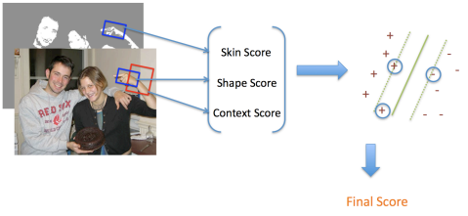
Hypotheses Classification
Proposed hand boxes are scored by all three methods.
The three scores are combined together to get the final score using a linear SVM classifier.
The three proposal methods ensure good recall, and the discriminative classification ensures good precision.

Slide 11
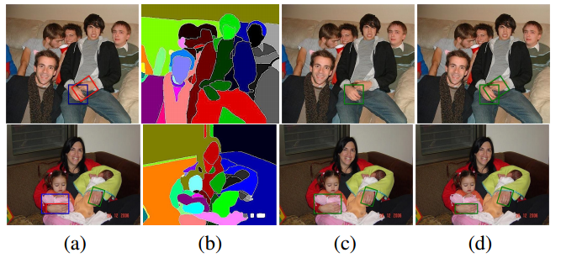
Super-pixel based non-maximum suppression
A hand’s appearance is often visually coherent and can be obtained as a single super-pixel.
Non-maximal suppression is done over all boxes overlapping the same super-pixel.
Comparison of conventional NMS with super-pixel based NMS. (a) Bounding boxes shown in blue and red are overlapping. (b) Superpixel segmentation of the image. (c) The red bounding box is suppressed by conventional NMS. (d) Super-pixel NMS retains the correct boxes.

Slide 12
Hand Dataset
This paper has collected a comprehensive dataset of hand images.
Download link: http://www.robots.ox.ac.uk/~vgg/data/hands/
The annotation consist of a bounding rectangle, oriented with respect to the wrist.

Slide 13
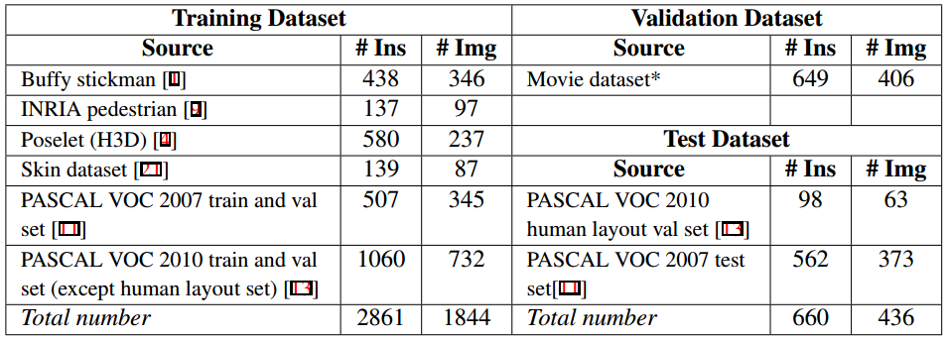
Hand Dataset
Table 1: Distribution of larger hand instances in the hand dataset. ‘# Ins’ is the number of hand instances, and ‘# Img’ the number of images. The movie dataset contains frames from the films ‘Four weddings and a funeral’, ‘Apollo 13’, ‘About a boy’ and ‘Forrest Gump’.

Slide 14
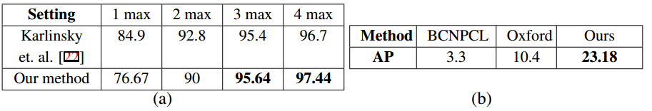
Results
Table 2: (a) Comparison of results on the Signer dataset.‘1 max’, ‘2 max’ etc. are the detection performance within the top ‘k’ hand detections per ground-truth hand instance. (b) Comparison of this paper’s method with other submissions for PASCAL VOC 2010 person layout challenge for hand detection task. Scores are obtained by submitting results to the competition evaluation server.

